Slide 1


Intro to
Programming
With python
Dictionaries:
part 1
Monday, April 14 2025 TOH210
Notes:
Layout objects pulled from: https://slidesgo.com/
All icons are from: https://thenounproject.com/

Slide 2

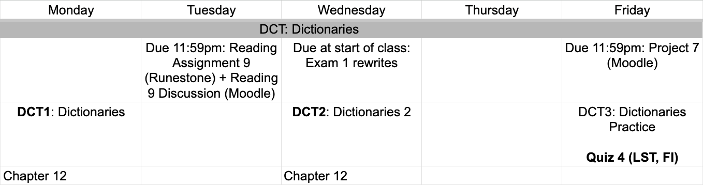
This week
google sheet link
Notes:
https://docs.google.com/forms/d/e/1FAIpQLSe3OloPAJSid4n6cyU_4qXpRWU7FOSmP7IVdRS_vh9cvYd9zQ/viewform?usp=sharing

Slide 3
Things to keep in mind:
Write up your program and see if it runs! This is the best way to debug your written code.
Ask for clarification if you need it. Go to office hours or help sessions.
Only Rs can be bumped up to Ps. However, if you received an I you can also hand in a solution. It won’t change your score, but it’s a really great way to get more feedback!
exam 1 rewrites
due Wednesday

Slide 4
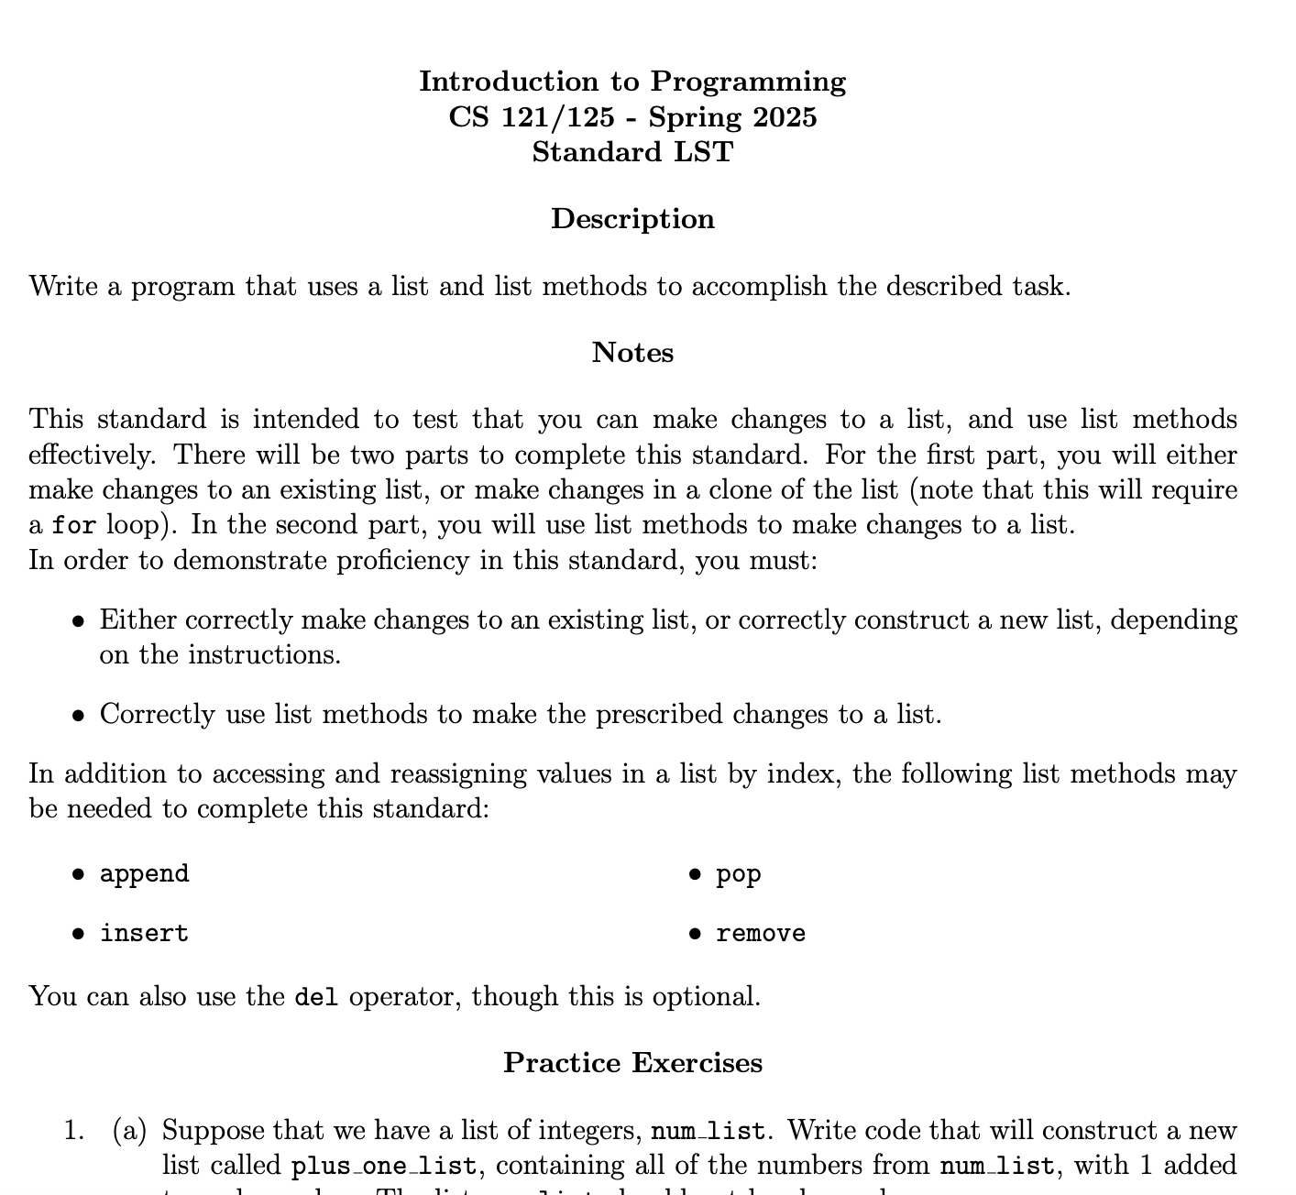
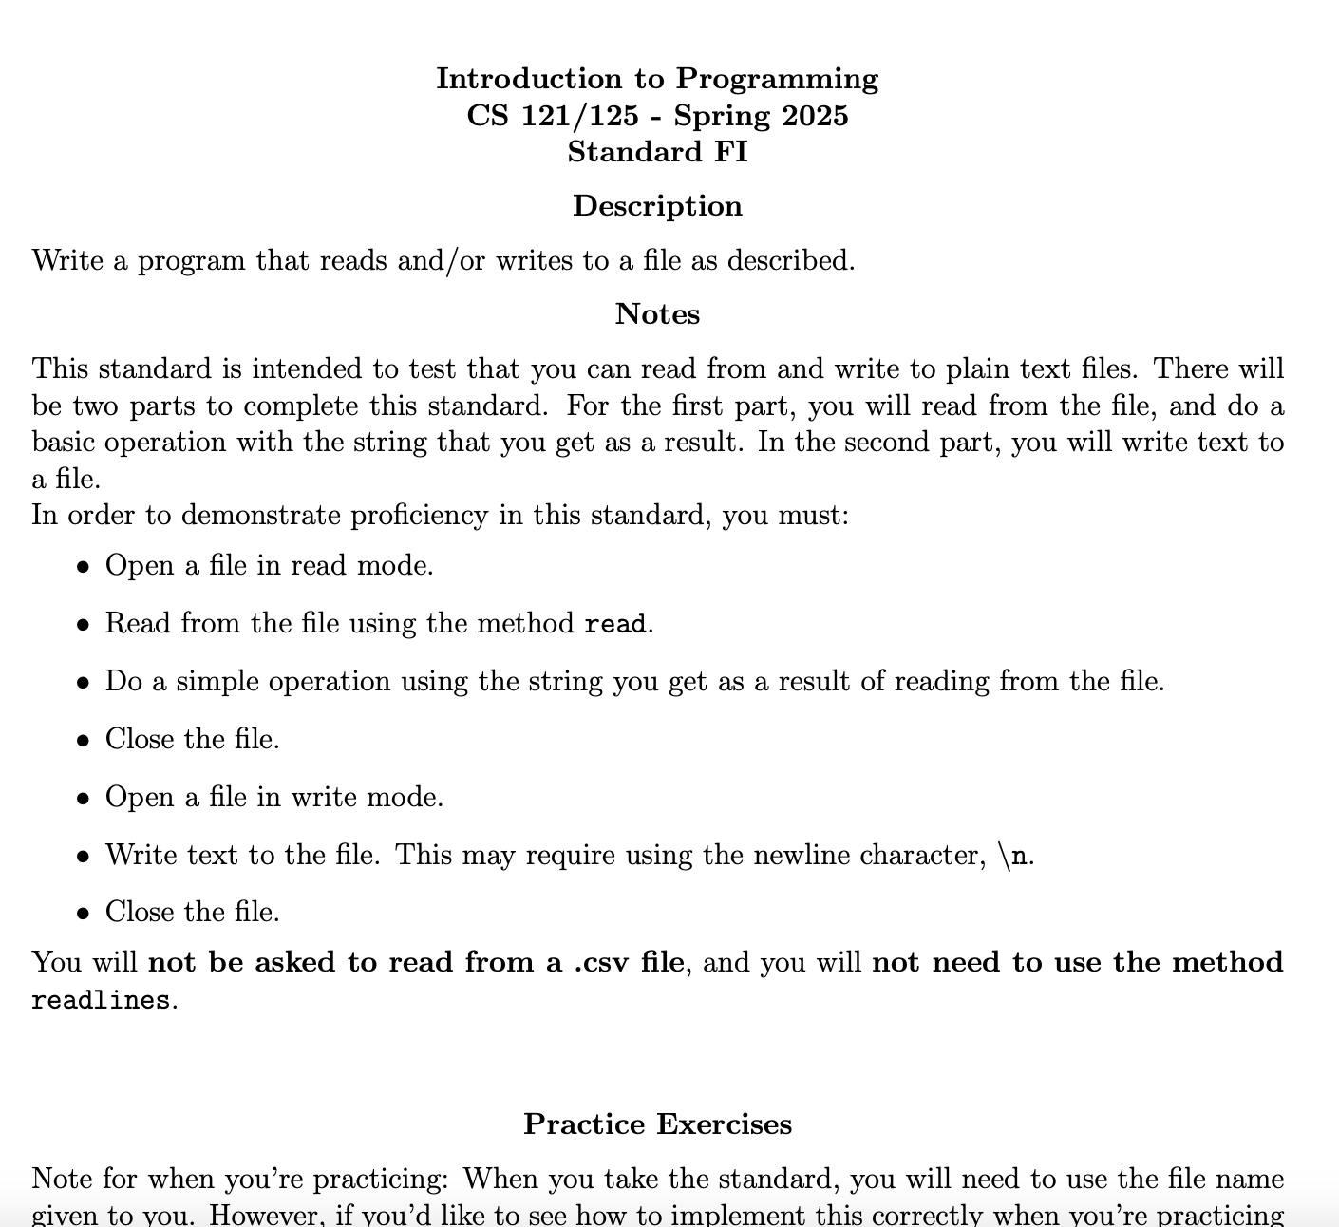
Quiz 4 on Friday! Practice exercises up on Moodle.
Stop by TA help sessions or office hours if you have any questions on these

Slide 5
Things to keep in mind:
Start early. Go to office hours or help sessions if you have any questions.
Benford’s law is also called the leading digit phenomena. Ex: 10 234 3223
You’d likely expect leading digits to be uniformly distributed. This means 1 and 9 would be equally likely to occur 1/9 or ~11% of the time.
In actuality 1’s are way more likely to occur (~30%) than 9’s (~6%).
If we do not see this phenomena, we may be suspicious of the data source
Project 7
due Friday

Slide 6
dictionaries 1
colab workbook
click for access
found on Moodle under this week

Slide 7
Takeaways from last time
Things you should know:
reading text and csv files
writing text file
converting csv to list-of-lists
practice with list methods
practice with string methods

Slide 8


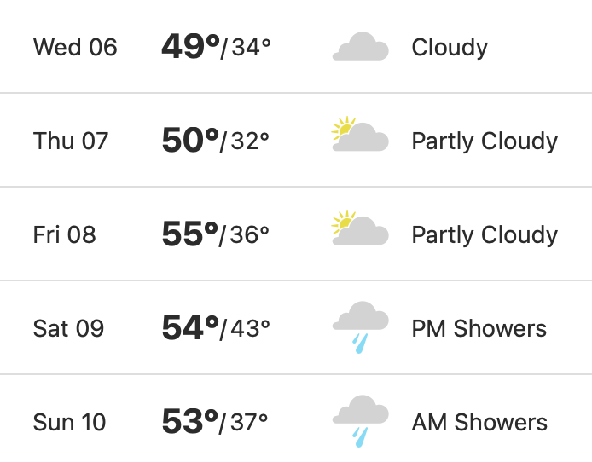
WARMUP
5-day weather forecast
We would like to store the following weather data:
Grab a partner and a whiteboard marker.
How many different ways could you store this information (hint: what are all the data structures we’ve learned about over the course of this semester?).
Which option would you prefer to work with?

Slide 9
days = ["Wednesday", "Thursday", "Friday"]
temps = [49, 50, 55, 54, 53]
lists
We’ve seen that lists can be used to store different types of information
Lists can be thought of as a structure for organizing information
namespace
objectspace
In a list, data is organized by index, or by the order that the values are put in the list
"Wednesday"
days
0
1
"Thursday"
2
"Friday"

Slide 10
In a list, data is organized by index, or by the order that the values are put in the list
Example: for social media (or anything with accounts really), what kinds of information can be stored?
age, email, phone numbers, addresses, usernames, password, birthday, posts, friends, followers
For some applications, this type of organization may not make sense
Lots of different ways to organize data and information using different types of containers

Slide 11
Example: a social media profile has the following types of information:
data structures
In designing a program, one of the most important choices you make is how to organize your information.
phone numbers, username, password, swiping tendencies, posts, friends, likes…
This information needs to be used in order to interact with the application:
But how to choose? Well, choose the one that allows you to do all the things you want to do.
watch cat videos, recommendations, ads, comment

Slide 12
dictionary
In a Python dictionary, information is organized in key-value pairs
Keys are often strings, but can be ints or some immutable type like a tuple
Example: if you have a dictionary account that has a key "username", you can get something like the following:
A key has a similar role to an index in a list, as it is used to look-up a corresponding value
account["username"]
mander1

Slide 13
creating a dictionary
If we want to create a dictionary to store information for an account, we could do this by:
account = {"username" : "mander1" , "password" : "supersecret", "ID": 42 }
We can grab relevant information by looking it up by its associated key
account["username"]
account["ID"]
account["supersecret"]
"mander1"
42
KeyError: key not found
keys
values
"username" "password" "ID"
"mander1" "supersecret 42

Slide 14
Exercise
5-day weather forecast
We would like to store the following weather data:
Define a dictionary called temps that stoves the high temperature for each day last week. The keys should be the day of the week, and the values should be the high temperature.
Once you create your dictionary, you should be able to display the high for today with:
print(temp["Wednesday"])
should return 49

Slide 15
dict = {0 : "a" , 1 : "b", 2 : "c" }
adding to a dictionary
How can we add a new item to an existing dictionary?
dict[3] = "c"
unlike lists, we can do this to create new items!
dict is now {0 : "a" , 1 : "b", 2 : "c" , 3 : "c" }

Slide 16
example
word counts
Write a program that opens and reads from the file the_hobbit.txt, and constructs a dictionary called word_counts that stores the number of times each work occurs in the file.

Slide 17
exercise
character counts
Define a function called char_counts that takes a string as an argument, and returns a dictionary storing the number of times each character occurs in the string.
An example of the program executing is below:
char_counts("potato") will return {"p":1, "o": 2, "t":2, "a":1}

Slide 18
key-value stores: a type of database that provides fast access to records by key, and scales well for very large datasets
hash tables + hash functions: data structure used in password security, encryption, verifying file integrity
JSON: used for transferring objects over the internet
key-value pairs
The idea of key-value pairs is very useful, and shows up in many places other than Python dictionaries

Slide 19

before next time
Finish workbook
Reading 9 + Reflection
Finish Task 1 for Project 7
Exam 1 Rewrites

Slide 20
hobbit_file = open("the_hobbit.txt", "r")
hobbit_str = hobbit_file.read()
hobbit_words = hobbit_str.strip().lower().split() #removes newline characters, removes uppercase, and splits into list of words
word_counts = {} #create empty dictionary
for word in hobbit_words: #for each word in word list
if word not in word_counts.keys(): # if not in dictionary
word_counts[word] = 1 #add it with count initialized to 1
else: #if it’s in the dictionary already
word_counts[word] += 1 #increase the count by 1
print("hobbit occurs",word_counts["hobbit"],"times")
print("Bilbo occurs",word_counts["bilbo"],"times")
hobbit_file.close()
word counts

Slide 21
character counts
def char_counts(text:str)->dict:
"""takes a string as an argument, and
returns a dictionary storing the number
of times each character occurs in the string """
char_dict = {} #initialize dictionary
for char in text: #for each letter in the argument
if char not in char_dict.keys(): #if not counted yet
char_dict[char] = 1 #initialize first value count to 1
else: #if already in dictionary
char_dict[char] +=1 #add one to existing value
return char_dict

